Slide 1
Project Title: Customer Churn Analysis using Python
Project Synopsis: Developed a data analysis project to identify and visualize key patterns in customer churn behavior using Python and its data analytics ecosystem.
Project Description:
Analyzed a telecom customer dataset to understand factors contributing to customer churn.
Performed data cleaning and preprocessing using Pandas and NumPy.
Conducted exploratory data analysis (EDA) to assess churn proportions across gender, senior citizen status, contract types, payment methods, and service features.
Created insightful visualizations using Matplotlib and Seaborn, including bar charts, stacked bar charts, and distribution plots.
Generated actionable insights to help businesses target at-risk customer segments and reduce churn.
Demonstrated proficiency in data wrangling, visualization, and customer behavior analysis.
Tools & Technologies: Python, Pandas, NumPy, Matplotlib, Seaborn, Jupyter Notebook

Slide 2
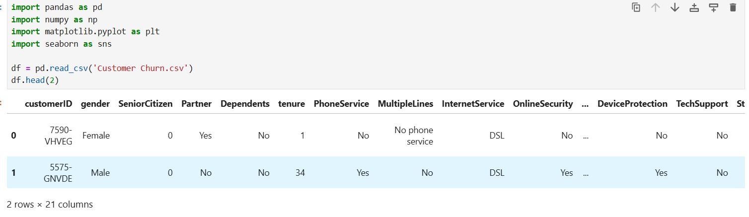
Import Required Libraries and Reading CSV File

Slide 3
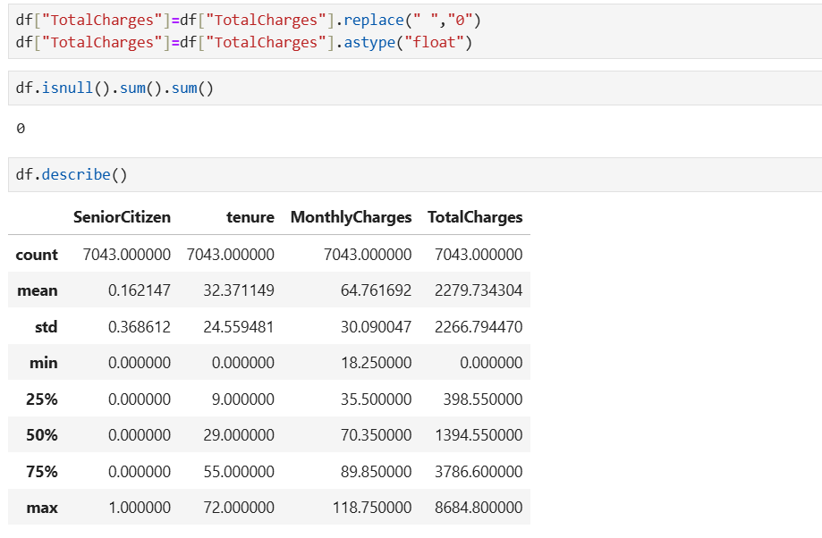
Cleaning Data:

Slide 4
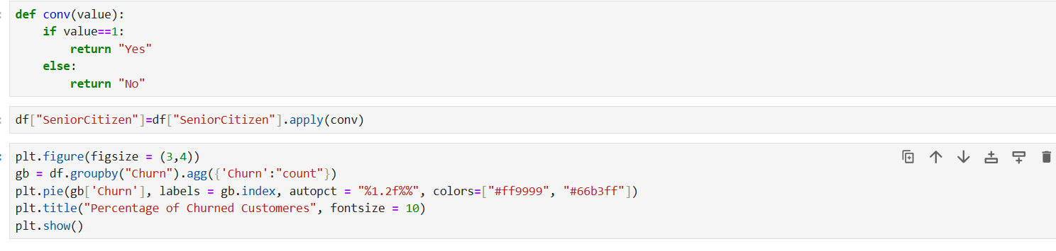
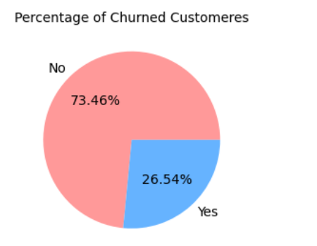
The Proportion of Churned vs. Non-churned customers:
Output:

Slide 5
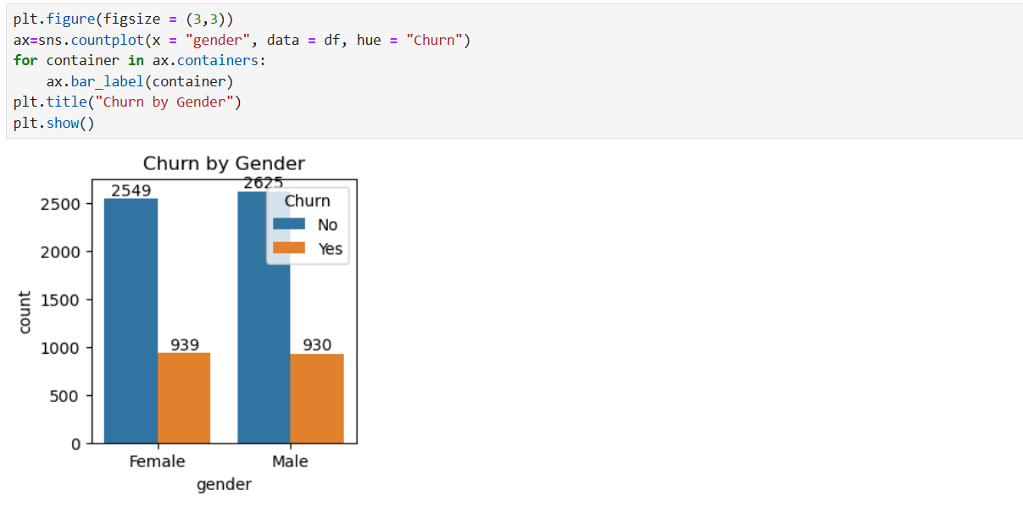
Count of Churned and Non-churned customers by gender

Slide 6
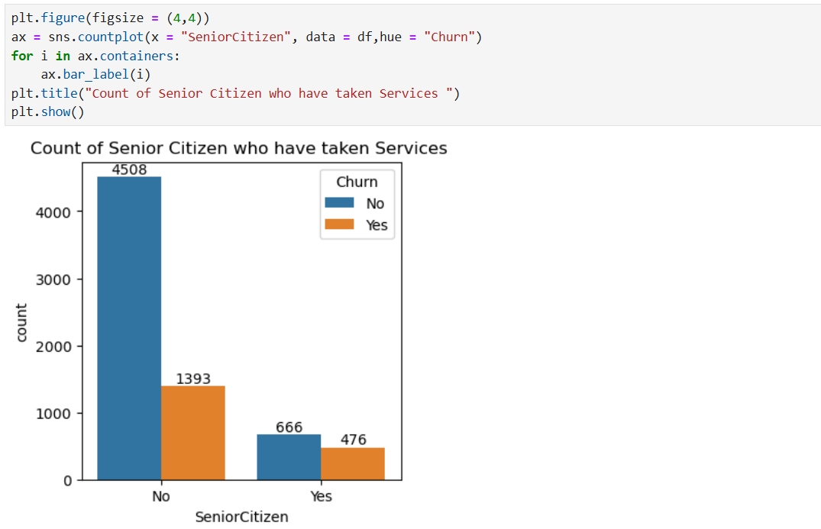
Count of Senior Citizen who have taken Services

Slide 7
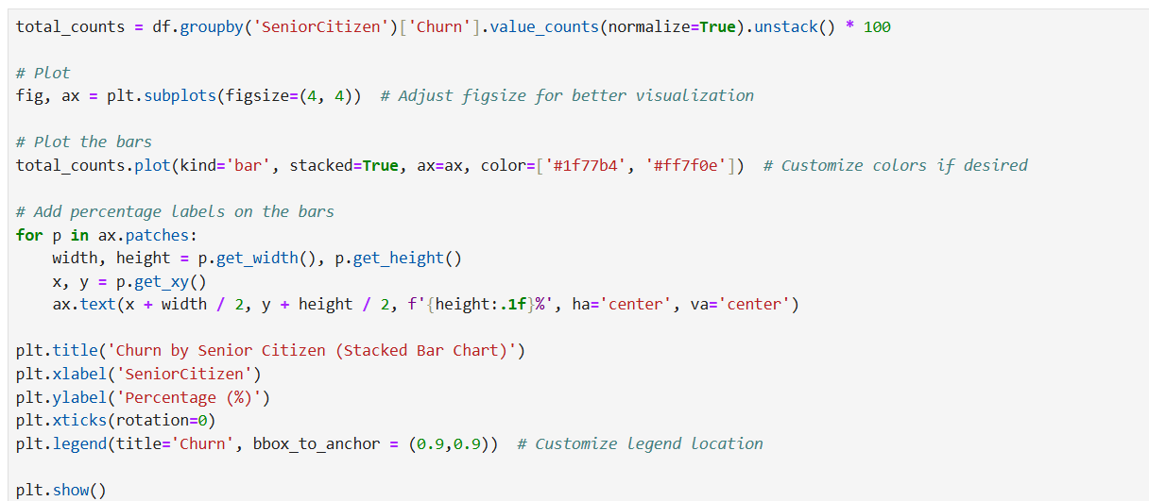
Churn by Senior Citizen (Stacked Bar Chart)

Slide 8
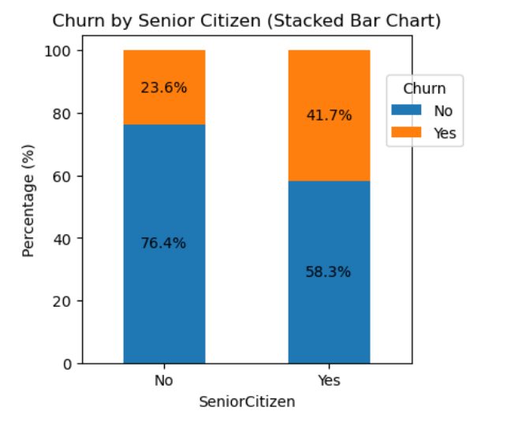

Slide 9
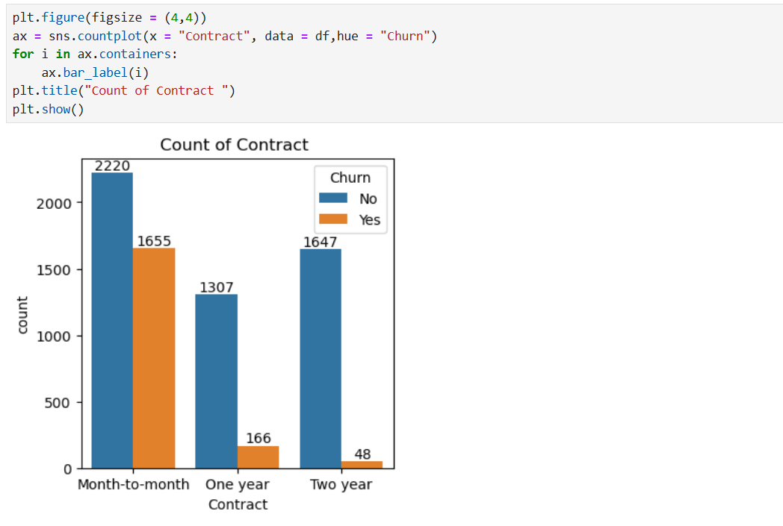
Count of Contracts

Slide 10
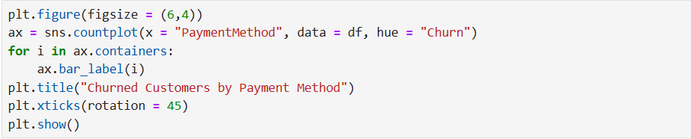
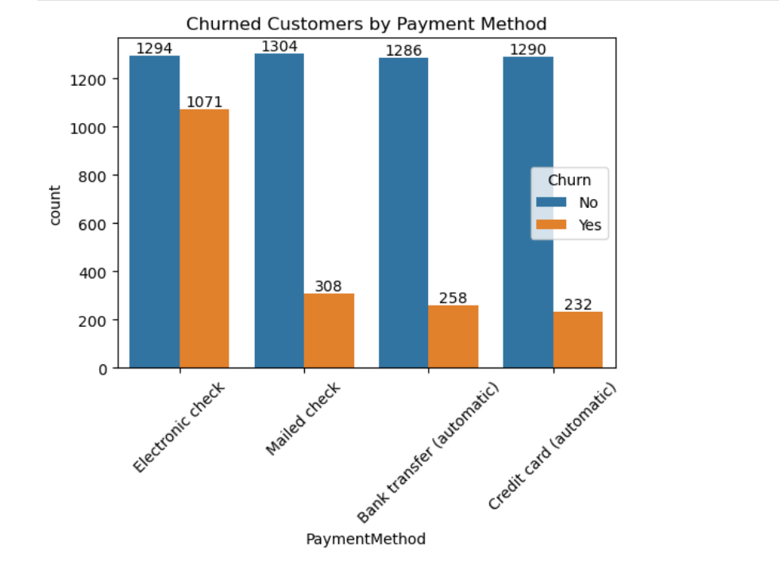
Churned Customers by Payment Method

Slide 11
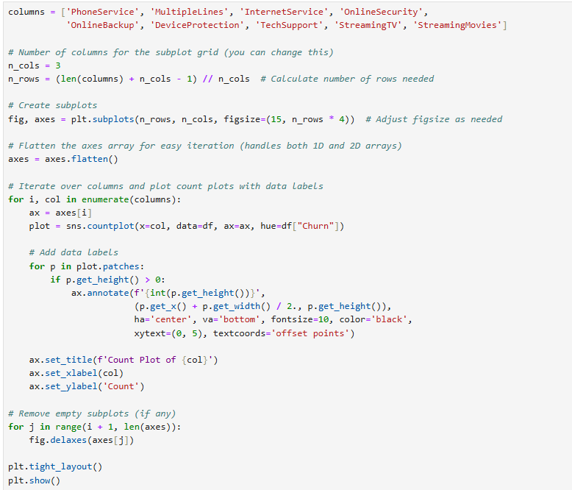
Customer Churn distributed across different service features:

Slide 12
